Slide 1
Hierarchical Planning in AI
By:
Jahnvi Kakkar (22WH1A6640)
Muskaan (22WH1A6650)

Slide 2
Introduction to Hierarchical Planning in AI
Definition:
Hierarchical planning in AI involves organizing tasks into multiple levels of abstraction, breaking down high-level goals into manageable sub-goals and tasks.
Importance:
Helps AI handle complex tasks efficiently by making decisions at various abstraction levels.

Slide 3
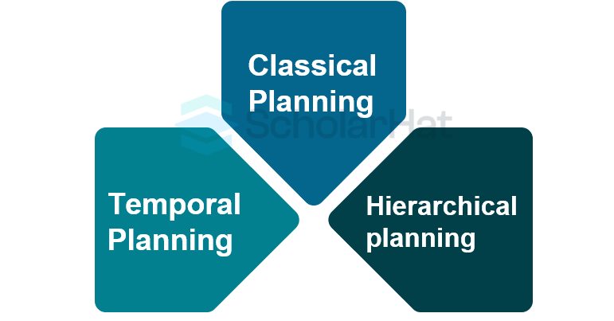
Components and Techniques of Hierarchical Planning
Components:
High-Level Goals: Guide the planning process.
Tasks: Actions to achieve goals.
Sub-Goals: Intermediate objectives.
Hierarchical Structure: Organizes tasks and goals.
Task Dependencies and Constraints: Determine task order.
Plan Representation: Hierarchical structures of tasks.
Plan Evaluation and Optimization: Ensures efficiency and feasibility.
Techniques:
HTN Planning: Decomposes tasks into sub-tasks.
Hierarchical Reinforcement Learning (HRL): Uses hierarchies for learning and decision making.
Hierarchical Task Networks (HTNs): Represents hierarchical task decomposition.
Hierarchical State Space Search: Explores state space hierarchically.

Slide 4
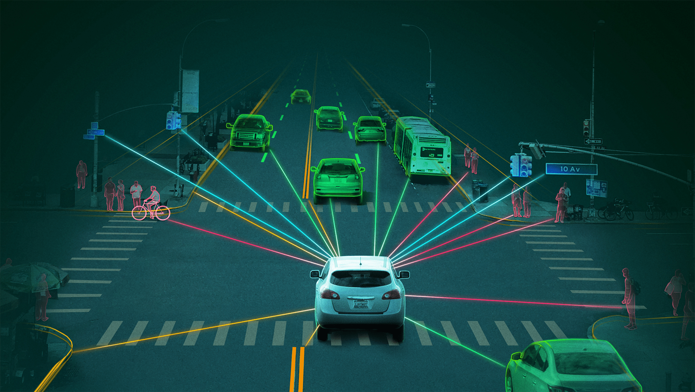

Hierarchical Planning in Autonomous Driving and Robotics
Autonomous Driving:
High-Level Goal: Safe navigation.
Major Steps: Route planning, obstacle avoidance, traffic signal recognition, lane keeping.
Minor Steps: Map analysis, sensor data processing, image recognition, lane detection.
Robotics:
High-Level Goal: Assemble electronic devices.
Major Steps: Component identification, assembly sequence planning, manipulation and grasping, quality control.
Minor Steps: Object recognition, task planning, grasping strategy, vision inspection.

Slide 5
Advantages and Challenges of Hierarchical Planning
Advantages:
Handling Complexity: Manages complex tasks efficiently.
Flexibility: Adapts plans to changes.
Reuse and Abstraction: Reduces redundant planning.
Higher-Level Reasoning: Facilitates strategic decision-making.
Challenges:
Planning Complexity: Computationally demanding with many tasks.
Adaptability: Requires significant resources for re-planning.

Slide 6
Thank You!

